Slide 1
HEART DISEASE PREDICTION USING RANDOM FOREST ALGORITHM
NAME OF THE SUPERVISOR:
Mr. M. VIGNESH ME.,
Assistant Professor,
Department of Artificial Intelligence and Data Science,
Karpagam Institute of Technology,
Coimbatore.
TEAM MEMBERS:
BALAJEEY R K (721220243005)
CHANDRU V(721220243006)
HARISH KUMAR M (721220243017)
HINDUMITHRAN G(721220243020)
Department of Artificial Intelligence and Data Science,
Karpagam Institute of Technology,
Coimbatore.

Slide 2
ABSTRACT
Heart disease is a major cause of death in the world today, and predicting it accurately is a major challenge. This paper presents a Random Forest algorithm which is used to predict heart disease based on various cardiovascular features.
The Random Forest algorithm is an ensemble method which combines multiple decision trees to make a final prediction. The dataset is divided into training and testing sets, and a 5-fold cross validation is applied to the training set.
The performance of the model is evaluated using accuracy, precision, recall, and F1 score metrics.
The results show that the Random Forest model is able to achieve a high accuracy of 94.07%, and the F1 score of 3.83 indicates that the model is able to accurately classify both the positive and negative cases.
This paper can help medical practitioners to accurately diagnose and treat heart diseases.

Slide 3
EXISTING SYSTEM
KNN(K- NEAREST NEIGHBOURS)
KNN (K-Nearest Neighbors) is a supervised machine learning algorithm used for classification and regression.
DECISION TREE ALGORITHM
A decision tree is a flowchart-like tree structure where an internal node represents feature(or attribute), the branch represents a decision rule, and each leaf node represents the outcome.
NAIVE BAYES ALGORITHM
Naive Bayes is a supervised machine learning algorithm that is based on Bayes' theorem, which states that the probability of an event is equal to the prior probability of the event multiplied by the likelihood of the event.
LIMITATIONS
Space complexity refers to the total memory used by the algorithm.
This algorithm faces the 'zero-frequency problem' where it assigns zero probability to a categorical variable whose category in the test data set wasn't available in the training dataset.
Overfitting. Feature Reduction & Data Resampling. Optimization.

Slide 4
RANDOM FOREST ALGORITHM
Random Forest is a type of ensemble learning method for classification and regression problems in machine learning.
It combines multiple decision trees, trained on different subsets of the data, to make a prediction
The idea behind this method is that a group of weak models, when combined, can create a strong model.
The final prediction is made by averaging the predictions of all the trees in the forest.
This helps to reduce the overfitting problem and improves the accuracy of the model.
Benefits:
Improved accuracy
Handling missing values
Handling categorical variables
Feature importance
Robustness
Versatility

Slide 5
LIST OF MODULES
Module 1
Data collection, Data preparation and cleaning.
Module 2
Splitting the dataset into train, validation and test dataset.
Module 3
Loading the training and testing dataset to the ML model.
Module 4
Predicting the accuracy of the model and visualize the outcome

Slide 6
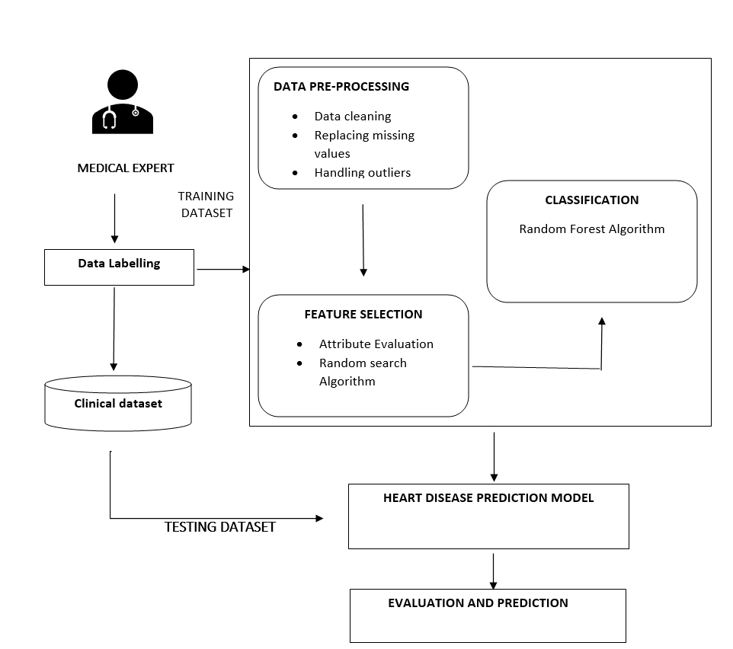
OVERALL ARCHITECTURE DIAGRAM

Slide 7
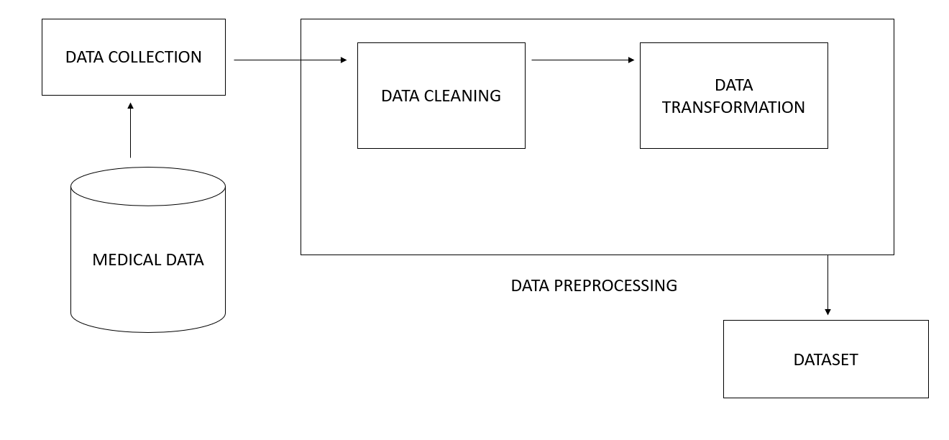
DATA COLLECTION, DATA PREPARATION AND CLEANING
Here the collection of data is done from medical data.
In our dataset “ heart.csv there is no noise in the data and there is no need for doing the cleaning the dataset

Slide 8
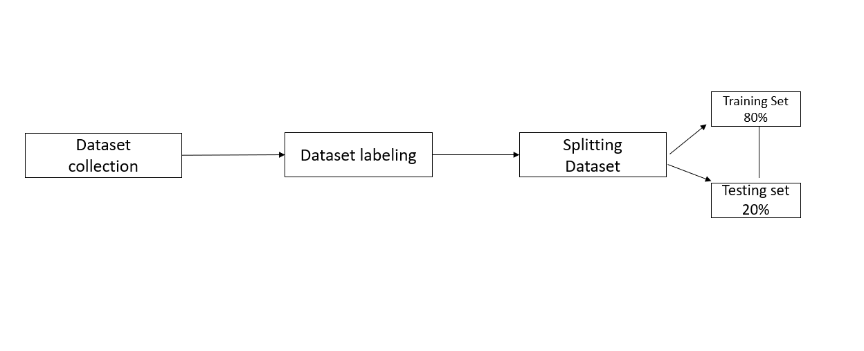
SPLITTING THE DATASET INTO TRAIN, VALIDATION AND TEST DATASET
The MinMaxScalar procedure is used to estimate the performance of machine learning algorithms while splitting the dataset into train and test data..
So, here we split the dataset into 80-20% of form. In this the total dataset can be divided into 80% data is for training dataset and the remaining 20% dataset if for testing dataset, this all done by using “ train_ test_ split()” technique from sklearn library.

Slide 9
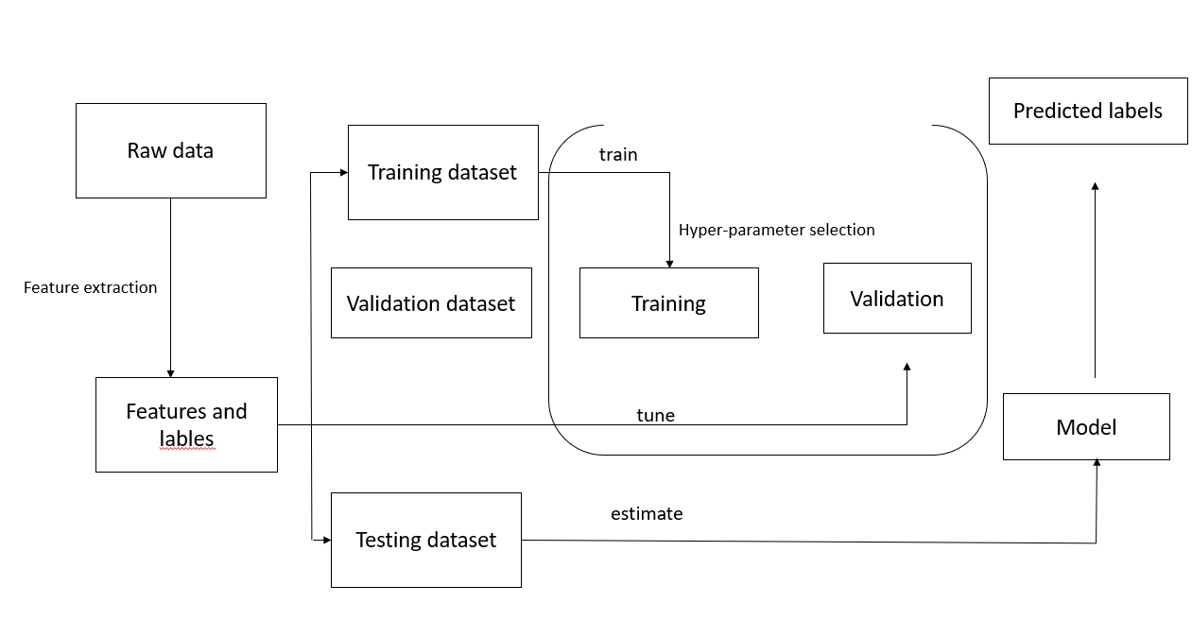
LOADING THE TRAINING AND TESTING DATASET TO THE ML MODEL
After loading train and test data in the ML model, the ML model is trained using random forest classifier

Slide 10
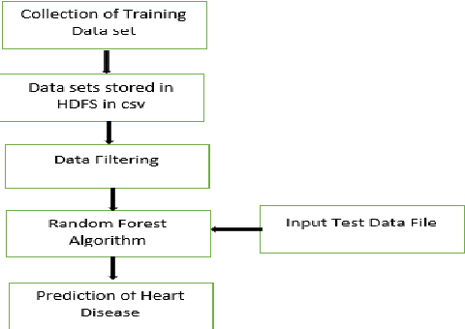
Predicting the accuracy of the model and visualize the outcome

Slide 11
SAMPLE SOURCE CODE
# Importing the libraries
import numpy as np
import pandas as pd
from sklearn.model_selection import train_test_split
from sklearn.ensemble import RandomForestClassifier
from sklearn.metrics import accuracy_score
import warnings
warnings.filterwarnings("ignore")
# Load the diabetes dataset
data = pd.read_csv("/content/heart.csv")
data.head()
data.isnull().sum()
data.describe()
data.head(0)
# Split the data into features and labels
X = data[["age","chestpain","trestbps","cholestrol","fasting_blood_sugar","rest_ecg","thalach","exang","oldpeak","slope","ca","thal"]]
y = data["target"]
# Split the data into training and test sets
X_train, X_test, y_train, y_test = train_test_split(X, y, test_size=0.6, random_state=55)
# Train a Random Forest classifier on the training data
clf = RandomForestClassifier(n_estimators=100, random_state=55)
clf.fit(X_train, y_train)

Slide 12
# Make predictions on the test data
y_pred = clf.predict(X_test)
# Calculate the accuracy of the model
accuracy = accuracy_score(y_test, y_pred)
print("Accuracy:", accuracy)
numbers = []
h=0
for i in range(12):
ind=["Age :","ChestPain :","Trestbps :","Cholestrol :","fasting_blood_sugar :","rest_ecg :","thalach :","exang :","oldpeak :","slope :","ca :","thal :"]
num = input(ind[h])
numbers.append(num)
h+=1
pdr=clf.predict([numbers])
if pdr==[1]:
print("--------------------------------------------")
print("The Person is Affected by the Heart Diseases")
print("--------------------------------------------")
else:
print("------------------------------------------------")
print("The Person is not Affected by the Heart Diseases")
print("------------------------------------------------")

Slide 13
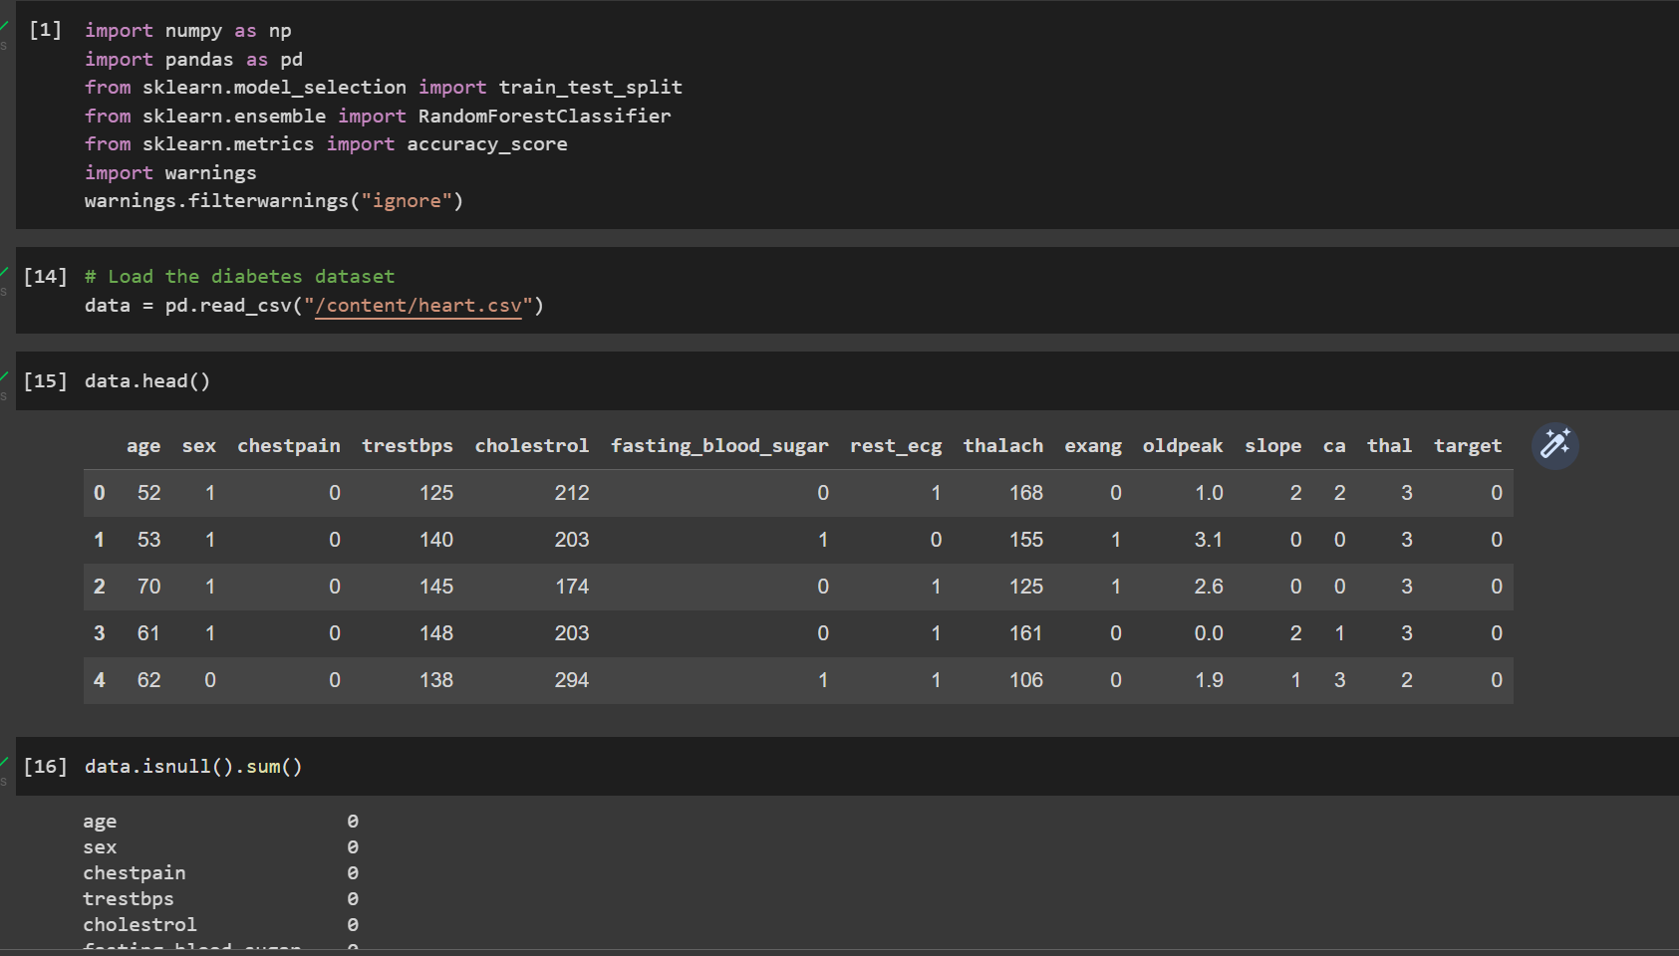
SAMPLE OUTPUT
Figure 1
By importing the pandas library which is used to manipulate the data sets, i.e. to edit, change, and replace particular elements of a DataFrame class object. Saving the csv file and then reloading it using read_csv.

Slide 14
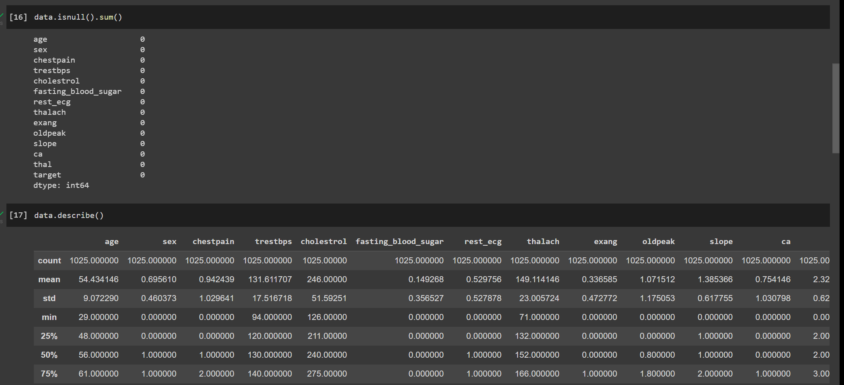
Figure 2
Figure 2
Checking the dataset where it has any null values using isnull() function and describing the data.

Slide 15
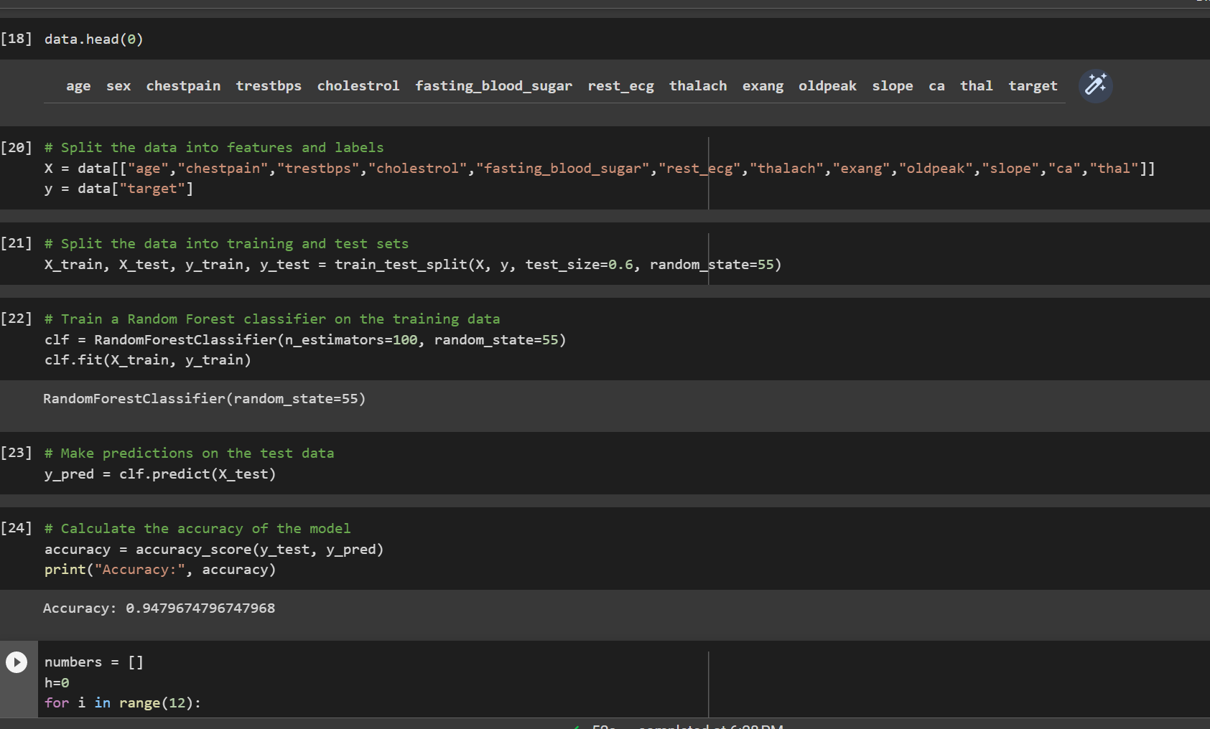
Figure 3
Splitting the dataset as train and test datasets and classifying the
data using RandomForestClassifier() and predicting the data and
calculating it’s accuracy_score .

Slide 16
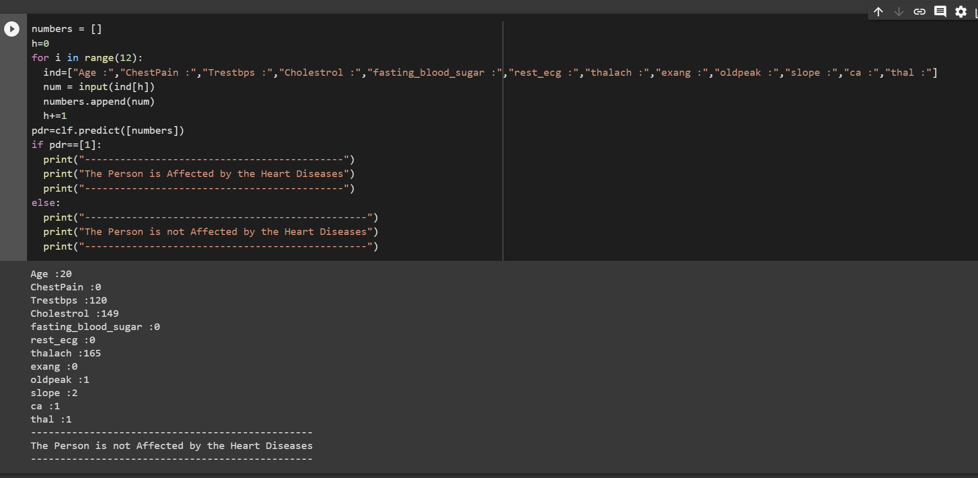
Figure 4
Prediction is done using the test data with the help of classifier and predict function .
Finally produces the output whether the person is infected with heart disease or not .

Slide 17
REFERENCE
J. L. Zulueta, V. L. Vida, E. Perisinotto, D. Pittarello, and G. Stellin, ‘‘The role of intraoperative regional oxygen saturation using near infrared spectroscopy in the prediction of low output syndrome after pediatric heart surgery,’’ J. Cardiac Surg., vol. 28, no. 4, pp. 446–452, Jul. 2013.
M. Shouman, T. Turner, and R. Stocker, “Using data mining techniquesin heart disease diagnosis and treatment,” pp. 173–177, 2012.
P. V. Ankur Makwana, “Identify the patients at high risk of re-admissionin hospital in the next year,” International Journal of Science andResearch, vol. 4, pp. 2431–2434, 2015.
P. S. de Vries, M. Kavousi, S. Ligthart, A. G. Uitterlinden, A. Hofman, O. H. Franco, and A. Dehghan, ‘‘Incremental predictive value of 152 single nucleotide polymorphisms in the 10-year risk prediction of incident coronary heart disease: The rotterdam study,’’ Int. J. Epidemiol., vol. 44, no. 2, pp. 682–688, Apr. 2015.
Y. Khourdifi and M. Bahaj, ‘‘Heart disease prediction and classification using machine learning algorithms optimized by particle swarm optimization and ant colony optimization,’’ Int. J. Intell. Eng. Syst., vol. 12, no. 1, pp. 242–252, 2019.

